Slide 1

“Module:
FPS Conversations and Owner Macros”
“Behind every suspicious review lies an investigation that protects millions of travelers.”
@ Module 1
Welcome to Fraud Support Fundamentals

Slide 2
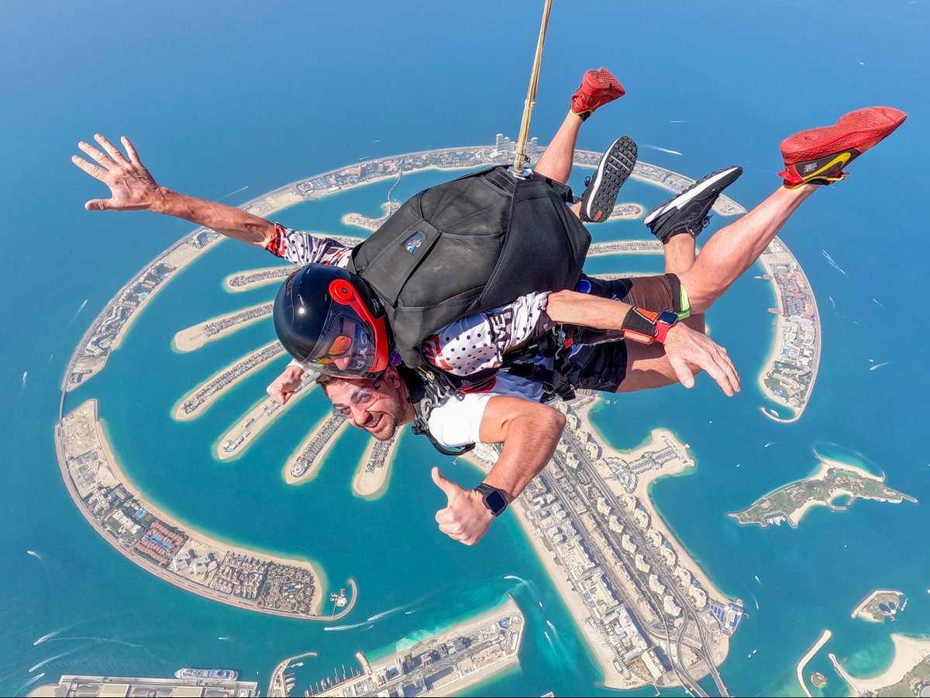
Dubai
01. Fraud Policy Support

Slide 3

FPS Conversation - Introduction
FPS - Fraud Prevention & Safety / Fraud Policy Support
An FPS Conversation is a specialized ticket or interaction type triggered when a property owner queries, disputes, or seeks clarification regarding fraud-related actions taken on their account or listing.
Tripadvisor / FPS Conversations & Owner Macros
1
Notes:
Example:
A hotel owner contacts Tripadvisor to clarify why their account was restricted due to suspected fake reviews, triggering an FPS Conversation to investigate and explain the fraud action.

Slide 4


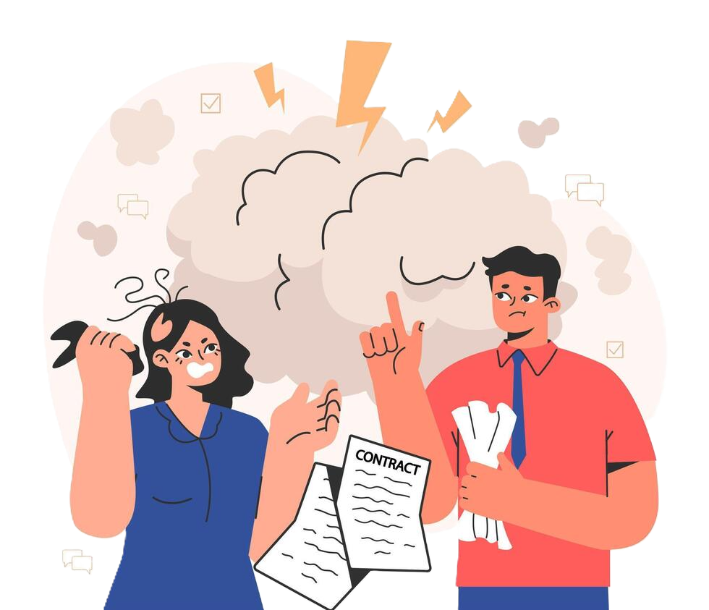

G al of FPS Conversations
Educate the owner about our fraud policies and guidelines
Address all concerns from the user (Owner)
Encourage compliance with our guidelines to prevent future fraudulent activity
Tripadvisor / FPS Conversations & Owner Macros
2

Slide 5



Who handles FPS Conversations?
The Investigations Team
Fraud Support Tier 1 agents
Fraud Support Tier 2 agents
Tripadvisor / FPS Conversations & Owner Macros
3

Slide 6
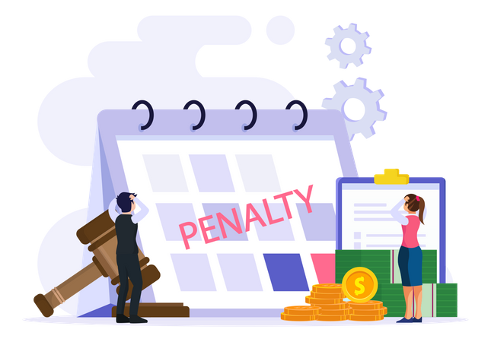





Common FPS scenarios
Owner Responding to a Fraud Letter
Owner Support Misdirected & Owner Response Misdirected
Ranking Drop Queries
Identify owner-written reviews not fraudulent, remove penalty, notify owner.
Check for fraud penalties in the last 12 months; use appropriate macros based on the findings
Verify violation, educate on policies, suggest GCF for mitigation.
Missing Guest Reviews
Test Reviews
Removed Traveler’s Choice Award
Treat explicitly marked test reviews as non-fraud and remove them without penalty. When doing so, set the removal type to "Regular Removal - other.”
Respond by educating the owner on guidelines, flagging suspicious patterns, or noting missing guest reviews based on fraud activity - active penalty, suspicious pattern, or minimal activity
Handle fraud-related removals as FPS; escalate non-fraud issues
Tripadvisor / FPS Conversations & Owner Macros
4

Slide 7



Common FPS scenarios (Conti…)
General Advice
Default Owner Settings & Staff Contact
Incorrect Penalties
Educate on fraud admissions and SEO patterns in reviews, noting that if only one fraudulent review contains SEO phrases, it should not be labeled as an SEO effort.
Manage email updates securely; handle staff disclosures confidentially
Overturn only if 100%
certain of error and no INV involvement
Note: Always prioritize policy enforcement and education over customer satisfaction in FPS cases
Tripadvisor / FPS Conversations & Owner Macros
5

Slide 8
Dubai
02. Agent Responsibilities & Actions

Slide 9
Pre-conversation Checklist
Confirm Affiliation - Verify the individual is an official representative
Confirm which property - Identify the correct property they are discussing
Violation type - Understand the specific policy violation. (Eg: Boosting, Vandalism)
Check for previous mitigation - Review Zendesk history and Guidelines compliance form (GCF) status for prior actions
Identify any required peripheral actions
Check and merge duplicate tickets
Tripadvisor / FPS Conversations & Owner Macros
6

Slide 10
Pre-conversation Checklist
Confirm Affiliation - Verify the individual is an official representative
Confirm which property - Identify the correct property they are discussing
Violation type - Understand the specific policy violation. (Eg: Boosting, Vandalism)
Check for previous mitigation - Review Zendesk history and Guidelines compliance form (GCF) status for prior actions
Check and merge duplicate tickets
Identify any required peripheral actions
Tripadvisor / FPS Conversations & Owner Macros
6

Slide 11
Agent responsibilities
Primary Responsibility
Double Check:
Always verify, even if another team already did
Never Assume:
Chain domains (e.g., @Viator.com) do not prove sub-brand affiliation
How to Verify:
Check the property’s official website or find verified owners with the same domain
Child/Parent Listings
Automatic Trust:
Main attraction owners are assumed to own child attractions
Verify First:
Confirm genuine affiliation before starting any conversation
Chain Listings (Sub-Brands)
Tripadvisor / FPS Conversations & Owner Macros
7

Slide 12
Key Communication Standards for FPS Interactions
Protect proprietary and confidential information
Understand clearly what can/cannot be disclosed
Agents must keep our anti-fraud efforts, privacy-protected information, and undisclosed company details strictly confidential
Provide sufficient information to help identify violation sources
Tripadvisor / FPS Conversations & Owner Macros
8

Slide 13

Information Sharing - Do's
If violations come from registered property owners or staff members close to guests
Type of violation (avoid internal terms)
Rough timing/velocity patterns (no specific dates)
Violation came from the current corresponding email or the property's official domain email
If fraud/warning letters were issued previously
If activity has stopped
If incentive surveys confirm the practice (without identifying specific reviewers)
Review text if written by the same email address and acknowledged by the sender
Penalty duration (except Red Badge cases)
Tripadvisor / FPS Conversations & Owner Macros
9

Slide 14
Information Sharing - Don’ts
Geographic location (domestic/international only)
Review text unless the sender confirms and admits they authored it
Pattern details such as IPs, proxies, passwords
User account details
Exact identity of violator (suggest general departments)
Exact fraud letter emails unless using a corporate domain or matching address
Exact dates of submission or removal
Penalty durations in Red Badge cases
Tripadvisor / FPS Conversations & Owner Macros
10

Slide 15

Information Sharing | Relevant macros
The most relevant macros are in:
Fraud Letter Basic Info
Fraud Letter More Info
The ‘Initial Contact with Owner’ macro contains editable sections:
Example:
"Unfortunately, because of our privacy agreement with all Tripadvisor members, I am unable to share details on what triggered our filters. However, I can tell you that we believe this activity comes from..."
...within your property and it's originated by members of your staff.
...a third-party vendor (webmasters, SEO agents, etc.).
...sophisticated technology that is not commonly associated with average users.
Tripadvisor / FPS Conversations & Owner Macros
11

Slide 16

Peripheral actions
Additional actions taken during case review beyond the original request
Must be documented in internal notes
Typically, not shared with the requester unless relevant
01
02
03
Examples:
Investigate and remove suspicious or fraudulent reviews.
Check and remove duplicate reviews.
Note: Add a comment in the internal note: pf of review 123456789 - Review ID (No other words need to be added)
Important: Peripheral actions are not predefined and will vary depending on the circumstances of each case.
Tripadvisor / FPS Conversations & Owner Macros
12
Notes:
Internal notes:
This section is used to document the research, decisions, evidence, and actions taken during the investigation. Internal notes are visible only to Tripadvisor employees. In the next silde you will be able to see an example for the internal notes.

Slide 17
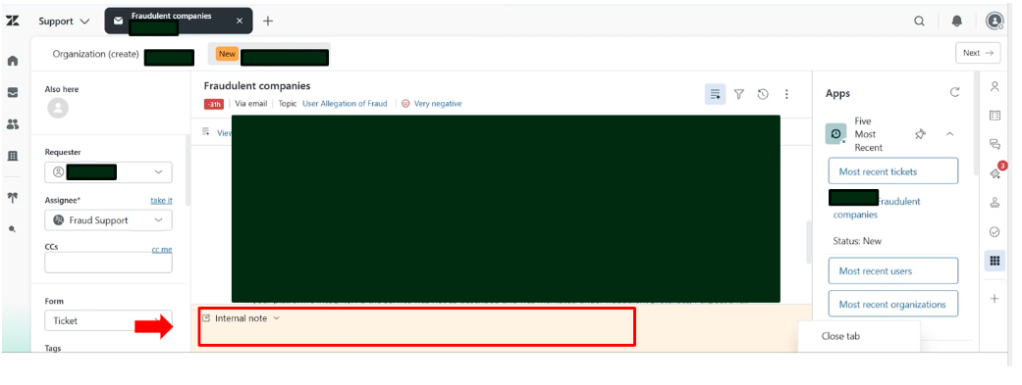
Internal Notes:

Slide 18

Things to avoid during an FPS Conversation
Sharing sensitive information with unauthorized individuals
Using Jargons during conversations
Advising repeated steps to the owners
Note: Reply to owners professionally and neutrally. Acknowledge the inquiry without disclosing internal investigation methods or decision criteria
Tripadvisor / FPS Conversations & Owner Macros
13

Slide 19


KNOWLEDGE CHECK
True or False?
Agents can share IP addresses or passwords with owners to show how fraud was detected.
TRUE
FALSE
Pattern details like IP addresses, proxies, and passwords are confidential and must never be shared with owners.
Tripadvisor / Fraud support / Knowledge check

Slide 20
KNOWLEDGE CHECK
What starts an FPS Conversation?
A traveler asking for a booking refund
An owner asking about a fraud penalty on their account
A guest writing a bad review about poor service
An owner changing their profile picture
Tripadvisor / Fraud support / Knowledge check

Slide 21
KNOWLEDGE CHECK
How far back should an agent check for past penalties during a ranking drop query?
Last 30 days
Last 6 months
Last 12 months
Lifetime of the account
Tripadvisor / Fraud support / Knowledge check

Slide 22
KNOWLEDGE CHECK
True or False?
Protecting policies and educating owners is more important than making the owner happy in FPS cases.
TRUE
FALSE
Guidelines state that agents must always prioritize policy enforcement and education over customer satisfaction during FPS cases.
Tripadvisor / Fraud support / Knowledge check

Slide 23
KNOWLEDGE CHECK
What should an agent do if a non-fraud issue causes a Traveler's Choice Award to be removed?
Treat it as an FPS issue and handle it immediately
Ignore the request and close the ticket
Escalate the non-fraud issue to the correct team
Automatically issue a new award to the owner
Tripadvisor / Fraud support / Knowledge check

Slide 24
KNOWLEDGE CHECK
What should agents AVOID doing during an FPS ticket?
Staying neutral and polite
Sharing private details with unauthorized people
Leaving internal notes on actions taken
Checking policy rules before replying
Tripadvisor / Fraud support / Knowledge check

Slide 25
KNOWLEDGE CHECK
True or False?
If an owner asks about missing guest reviews, an agent should automatically remove any fraud penalties on the account.
TRUE
FALSE
Agents must first check the fraud history; penalties are only removed if there is 100% certainty of an error.
Tripadvisor / Fraud support / Knowledge check

Slide 26
KNOWLEDGE CHECK
What must an agent do when performing peripheral actions (removing duplicate or suspicious reviews) on a ticket?
Email the travelers to inform them of the changes
Add a brief comment in the internal notes
Publicly post about the changes on the property page
Issue a full refund to the property owner
Tripadvisor / Fraud support / Knowledge check

